Slide 2

Real-World Hyper Automation in your MSP: From Theory to Practice
James Riley
CEO/Recovering Engineer
james@jnrnet.com
To add your headshot: Right click – change picture – from this device

Slide 3
Definitions
Process
A documented, step-by-step guide for how something is done.
Automation
A process defined well enough that it can be executed by someone or something else with appropriate escape paths.
Hyper Automation
The rapid deployment of automation, often leveraging AI, with minimal supervisory intervention, at a rate faster than individuals can directly manage.
RPA
Technology that performs automated tasks. (e.g., PLC, RMM, Rewst, etc.)

Slide 4
Automation in the Real World
Horror Stories
Great Stories
What makes great automation?

Slide 5
Why Automation
What are we really selling?
Where does automation help or hurt?
Enhances:
Codification
Consistency
Efficiency
Scalability
Accelerates outcomes, good or bad
Real benefit is the maturity, not just the automation

Slide 6
Key Automation Principles
Its not rocket surgery
Culture first - People Need to Value it
NEVER, NEVER, NEVER, EVER, Automate a Bad Process
Start Simple
Production Automation requires 30+ revisions
No automation will be 100%...build pressure relief valves/escape paths

Slide 7
Let’s Build Something…
Start Simple
Define Audience
Human Reactions
Job Loss
Reduced Quality
Author is the Owner
Escape Paths
Iterate

Slide 8
Human Factors
Fears
I’m going to be replaced
Automation reduces quality
I can’t be creative
Many struggle to systematize their thinking
Mastery = Know 50 ways to do something and codify a singular path
Chaos to Simplicity
Embrace the reality - Sometimes, process sucks
The author of the process is the owner of the process

Slide 9
What NOT to Automate…sort-of
Standardize the Norm, Humanize the Exception
Humanize Connection

Slide 10
Building Good Process
Start simple
Define what Good looks like
Define the audience/worker of the process
Build, test, iterate, repeat

Slide 11
Tips for AI Use
Co-Authoring can work great
Build a stock prompt defining culture/philosophy/why to give AI boundaries
Use AI to Ideate
I want to do x but have no idea where to start…what are some ways to think about this problem?)
I’m doing y, what are other ways I could do it?
Data analytics for prospective low hanging fruit (CSV export)

Slide 12
Key Takeaways
Get the Humans onboard
Get rid of bad processes
Start simple
Iterate
Accelerate
Build escape paths
The process is at least as valuable as the destination

Slide 13
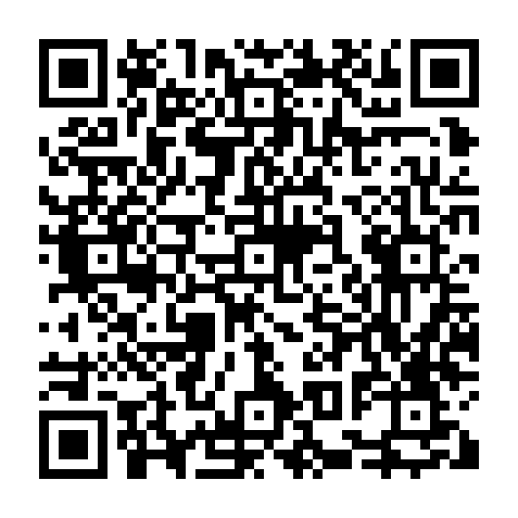
Q&A
Session Download

